Slide 1


Building Better Foundations for Roads Using Emerging Technologies
Soheil Nazarian, PhD, PE, DGE
Macintosh Murchison Endowed Chaired Professor
The University of Texas at El Paso
1
Notes:
Good afternoon, Ladies and Gentlemen. It is such an honor and pleasure to deliver the 4th Proctor lecture to you from Sydney Australia. I would like to thank the members of TC203 and the International society for selecting me for this honor. The focus of my talk will be on how to improve the longevity of the roads and other transportation facilities by incorporating the old and new technologies that are not commonly used.

Slide 2
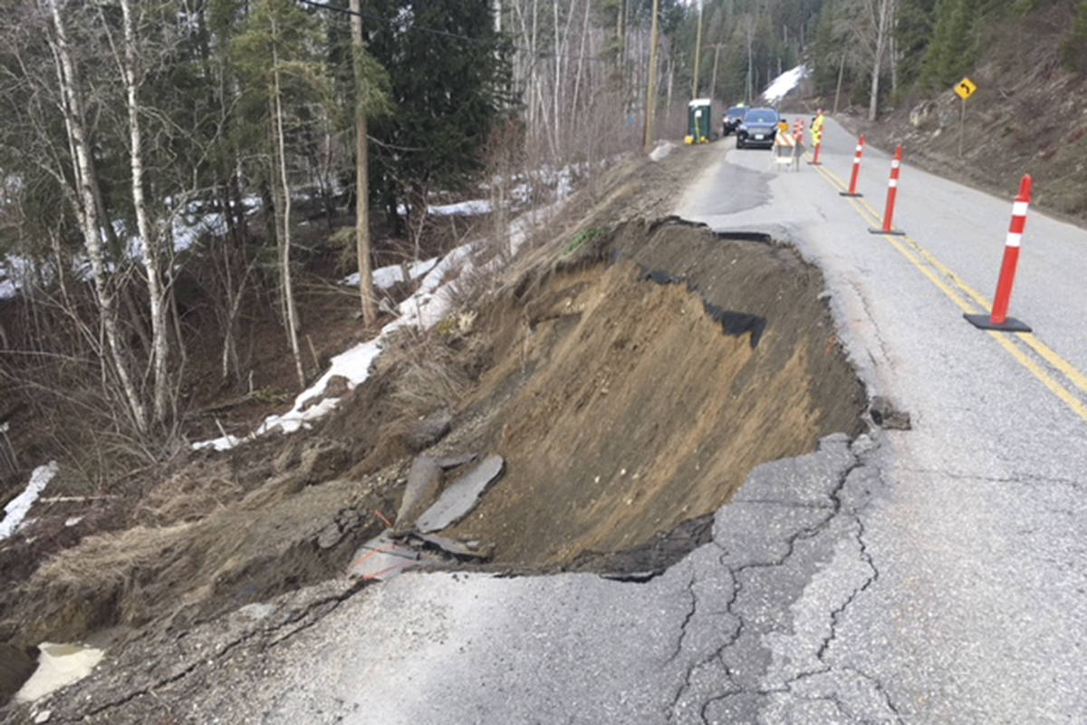
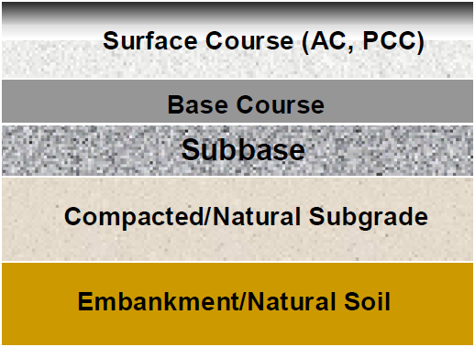
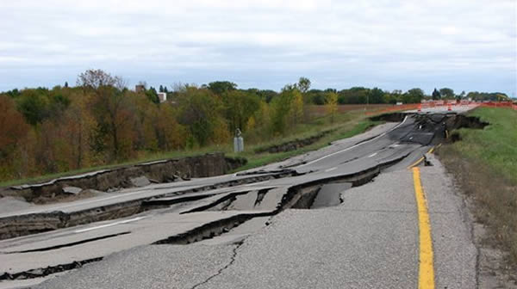
Role of Transportation System
    Safety Smoothness Durability
Layers important to smoothness and durability
Notes:
A typical pavement section consists of one or more surface layers being hot mix asphalt or concrete, often over a base (that can be stabilized) an optional subbase) and subgrade and natural soils. The focus of this talk is the foundation layers. These layers that significantly contribute to the smoothness and durability of the pavement structure are often not considered as important.

Slide 3
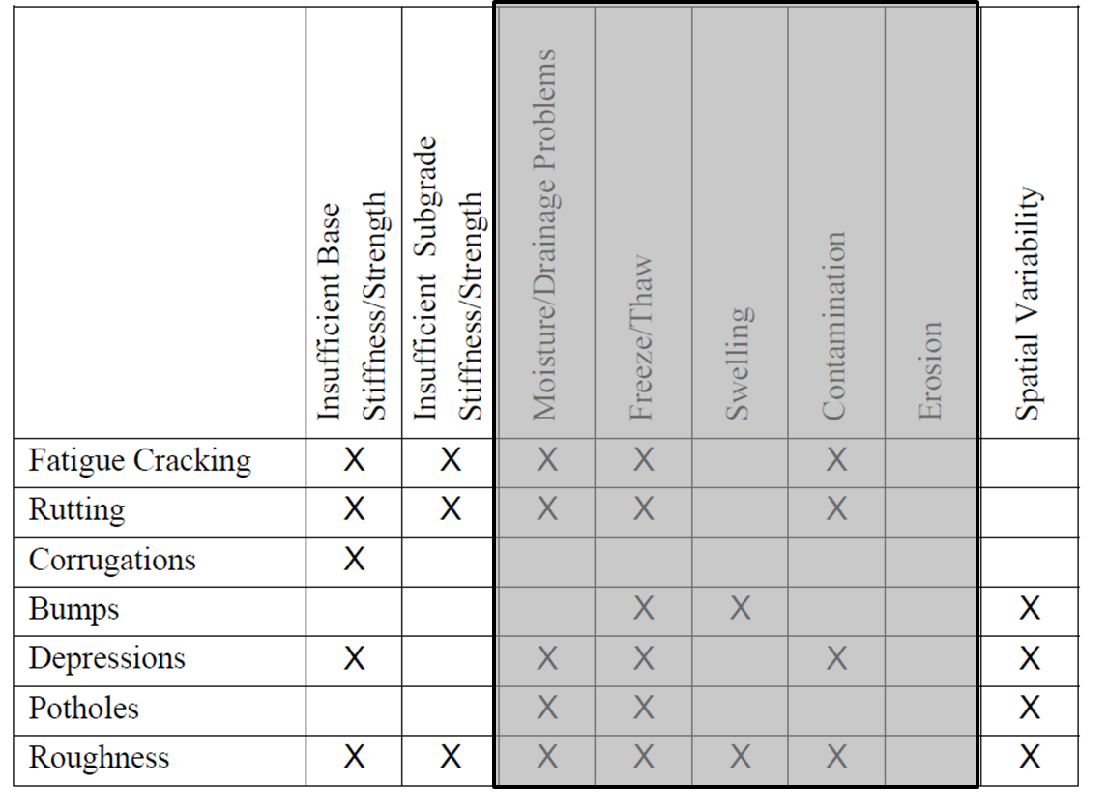
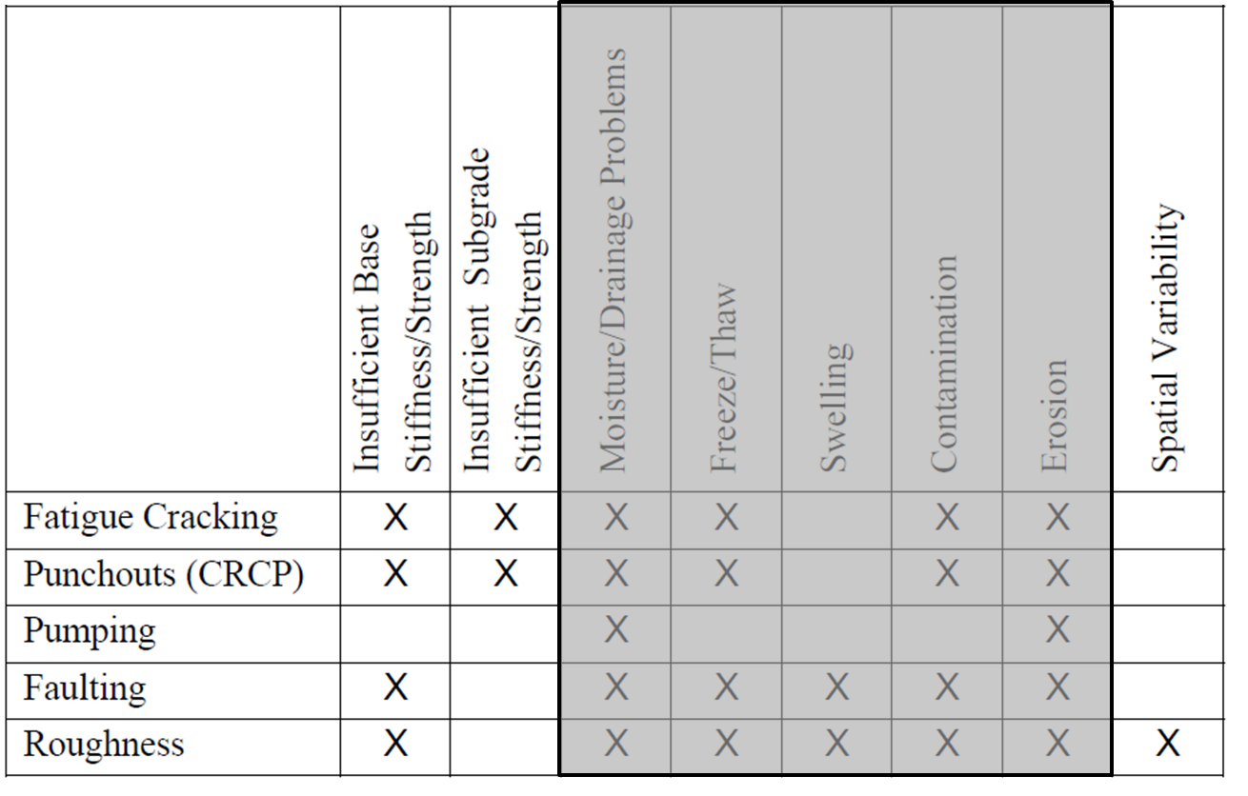

Source of Problem
Flexible Pavements
Rigid Pavements
Notes:
A quick survey of the literature quickly leads out to the understanding that the foundation layers are the source of a number of distresses. The focus of this talk is on two parameters the stiffness and uniformity of earthwork.

Slide 4
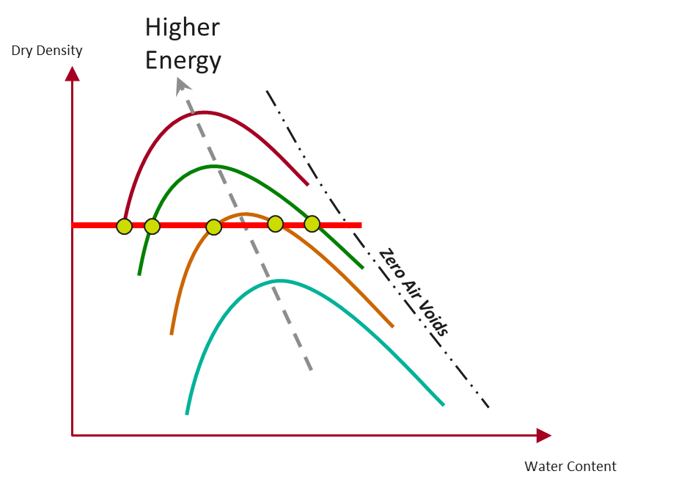
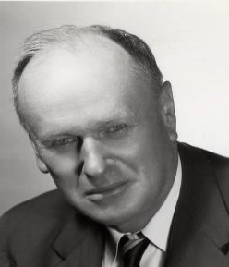
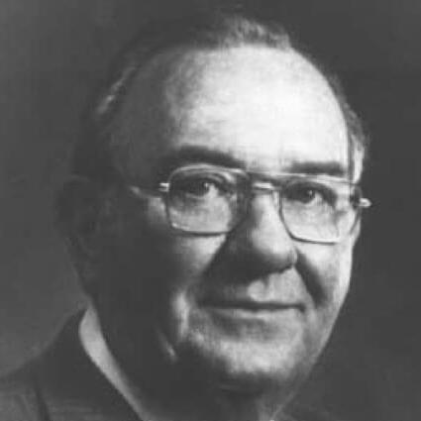
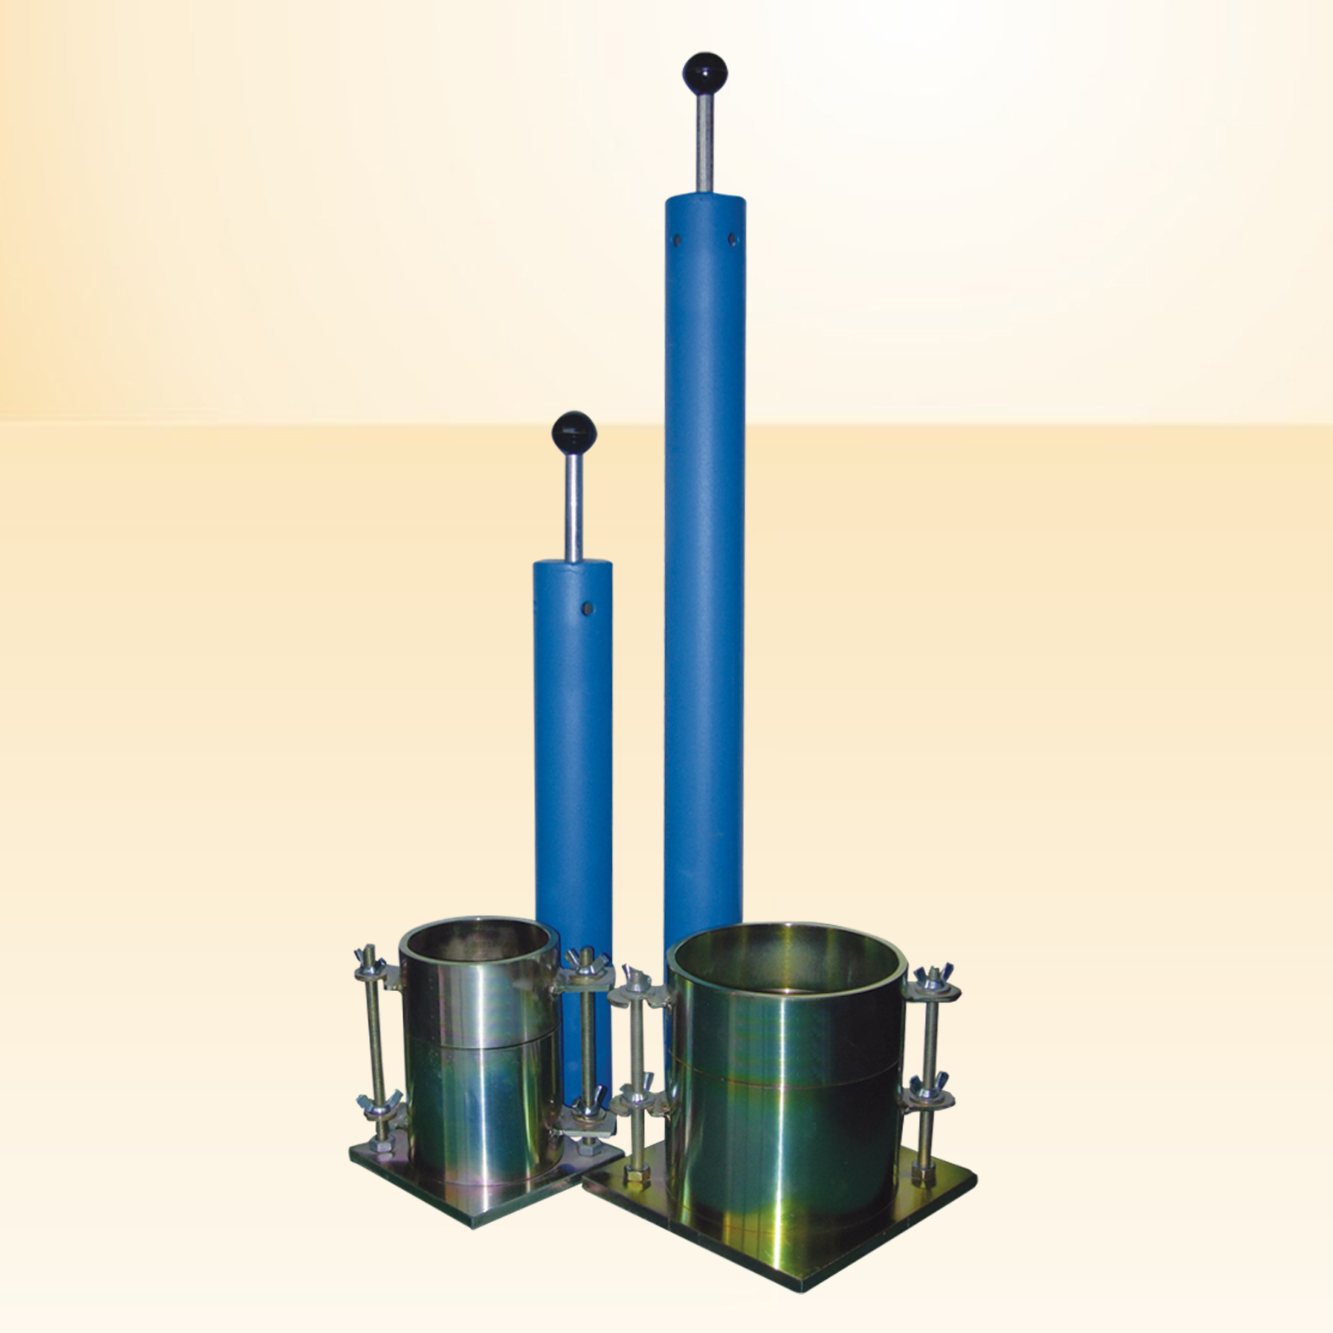
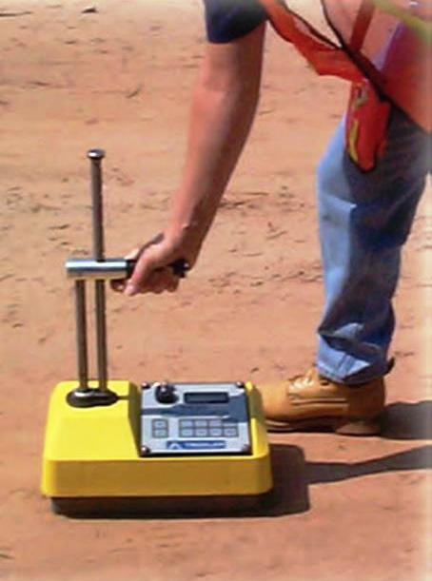
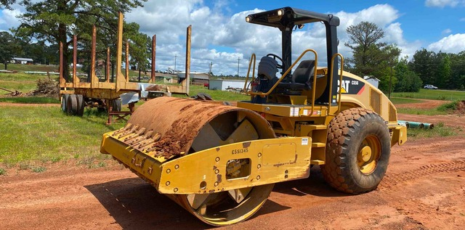
Traditional Density-Based Compaction
They did the best they could with what was available to them
~70 years ago to solve a major problem
Engineering community pragmatically agreed that these tests
improve quality, even though not perfect
Notes:
Let me reintroduce you to two of our superstars: Proctor in the left and Troxler in the right. Proctor introduced us with the concept of standard way of measuring density and optimum moisture content of different materials using a standard energy. Troxler introduced us to the concept of measuring the density using his nuclear density gauge based on the assumption that the density achieved in the Proctor mold will well represent the density of a roller going back and forth on a layer of soil.

Slide 5
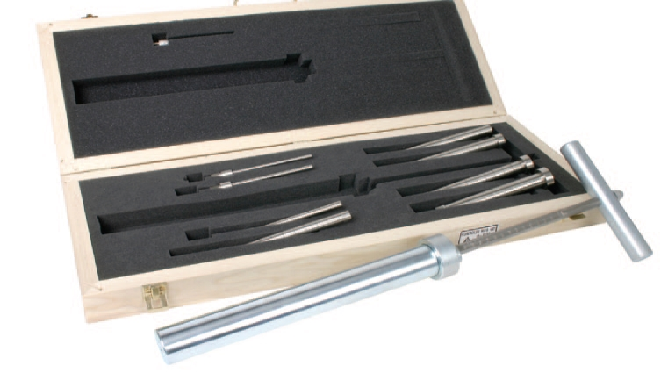
Famous Quotes of Ralph Proctor
  Strength is not achieved by density alone.
  Optimum moisture is for compaction.
Proctor(1945), Trans 110, ASCE
  “No use is made of actual peak dry weight.”
  “Measure of soil compaction used is penetration resistance.”
Proctor Penetrometer
Courtesy of John Siekmeier

Slide 6
In Support of Proctor Quotes
±2% Change in MC = 5% Change in DD but Huge Change in Modulus

Slide 7

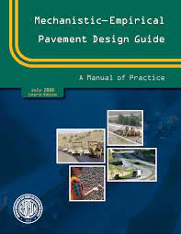
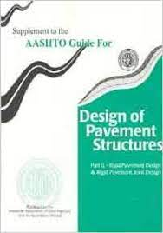

We have come a long way since then in Design!!
1970’s
1990’s
2000’s
2010’s
Modulus!! Modulus!!

Slide 8

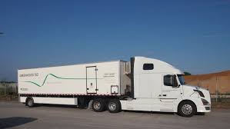
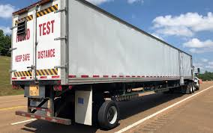
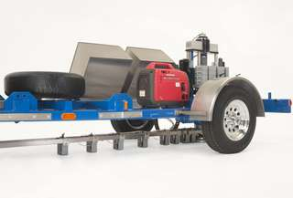
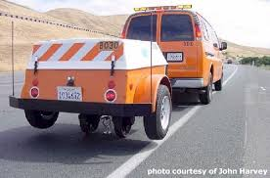
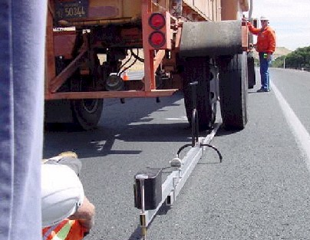
We have come a long way equipment wise!!
1950’s
1970’s
1980’s
1990’s
2000’s
2010’s
Modulus!! Modulus!! Modulus!!
8

Slide 9

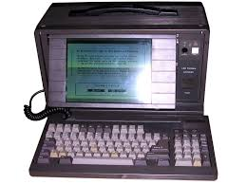

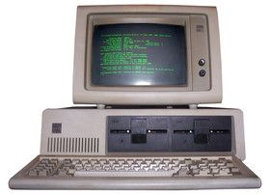
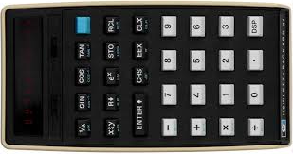

We have come a long way in Pavement Analysis!!
Modulus!! Modulus!! Modulus!!
How to diagnose structural health?
What index to use for network level?
How to implement effectively?
1950’s
1970’s
1980’s
1990’s
2000’s
2020’s
I am not getting any younger!!
How to use deflection?
Deflection?
Cool!!

Slide 10

Yet the State of Practice in Earthwork!!
Long Lasting Pavement
We do not check whether the modulus designer assumed is achieved
We do not check whether the material selected provides the modulus assumed by designer
We assume Lab Moisture-Density Curve represents Field Compaction process
Structural Design
Construction Quality
Material Selection
Not a good position to be

Slide 11
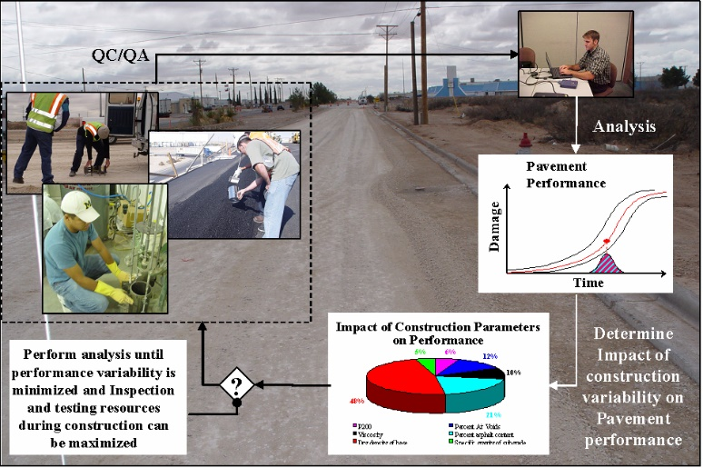
Eventual Goal
to ensure that pavement lasts for a pre-defined life uniformly
One way to reach it:
Settle on a design methodology
(e.g., Pavement ME)
Define Parameters that are directly important to performance
(e.g., modulus)
Focus on these parameters
Transition from QAQC
to
Performance Management

Slide 12

Appropriate Performance Management
Practical
Balance
Laboratory Testing Effort
Field Testing Effort
Analytical Modeling
Effort
Importance
of Project
Practicality

Slide 13
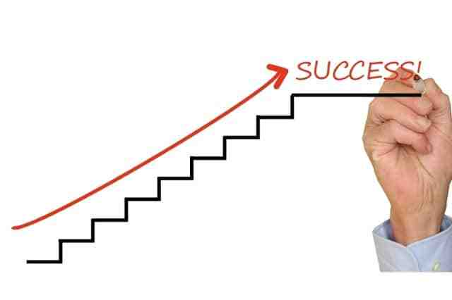
Major Steps for Appropriate Performance Management
Selecting Suitable Material
Selecting Appropriate Design Parameters
Selecting Target Field Values
Conducting Field Process Control
Establishing Acceptance Process

Slide 14
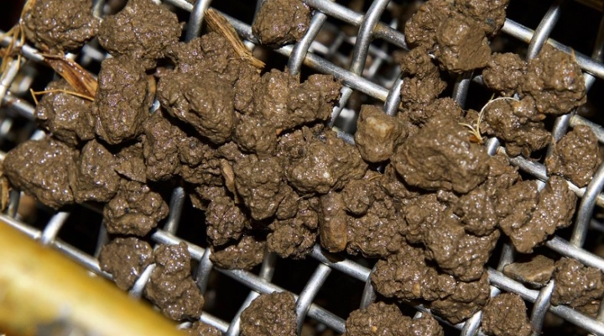
Selecting Suitable Material
A stiff/strong material does not correspond to a durable material.
Parameters, such as hardness of aggregates, percent fines and plasticity should be controlled for durability.
Do not abandon specifications on this subject

Slide 15
Selecting Appropriate Design Parameters
Conducting laboratory resilient modulus tests before structural design
Utilizing results from a catalog of most common soils that have been tested
Estimating modulus based on calibrated models that are functions of index parameters
Using presumptive design values based on experience
Best Option Worst Option
Set Target Values using design algorithm
Set target Values using design algorithm
Estimate target values using test strip
Use traditional density based approach

Slide 16
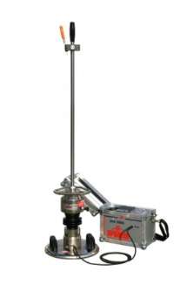
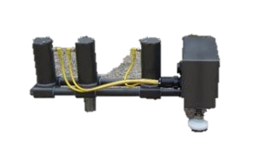
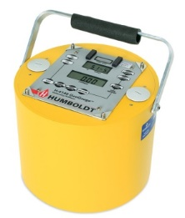
Selecting Target Field Moduli: Which Equipment?
n =20
COVs = 29±5%
ASTM E2835 LWD
ASTM E2583 LWD

Slide 17




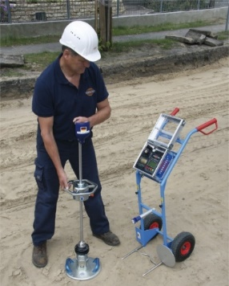
Selecting Target Field Moduli
Input
  Thickness of each layer
  Poisson’s ratio of each layer
  Modulus of each layer
Base
Subbase
Subgrade
Can easily be part of design
Output
  Target Deflection
17

Slide 18
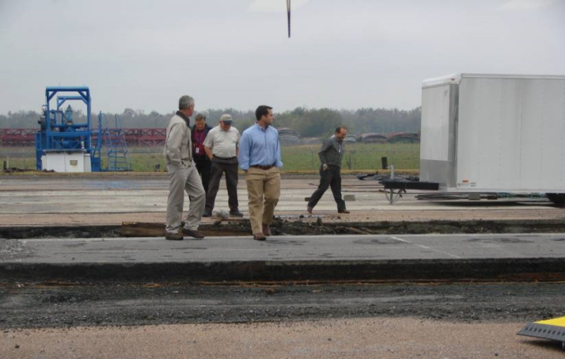
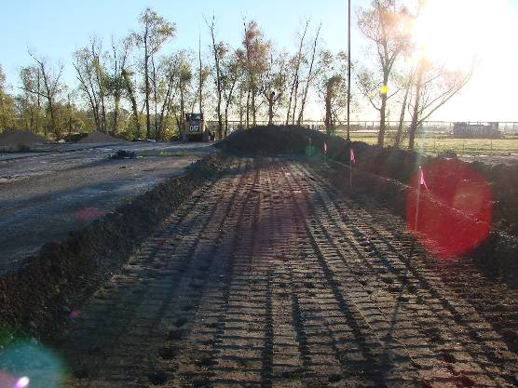
Impact of Moisture Content at Compaction

Slide 19
Field Process Control
Changes in material and moisture content have significant impact on modulus
Process control will ensure a more uniform and higher quality final product.
Quantifying variability is important to achieve uniformity
Need a strategy to manage variability
Need to ensure a rigid process control not less
Intelligent compaction can be used for this purpose
19

Slide 20
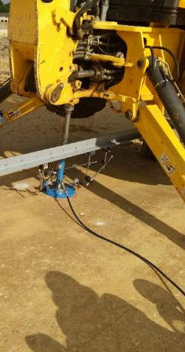
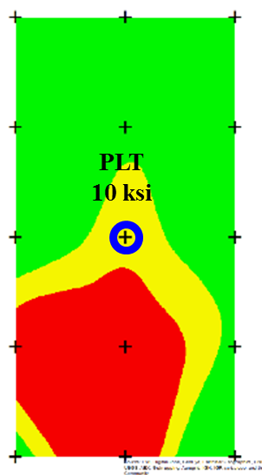
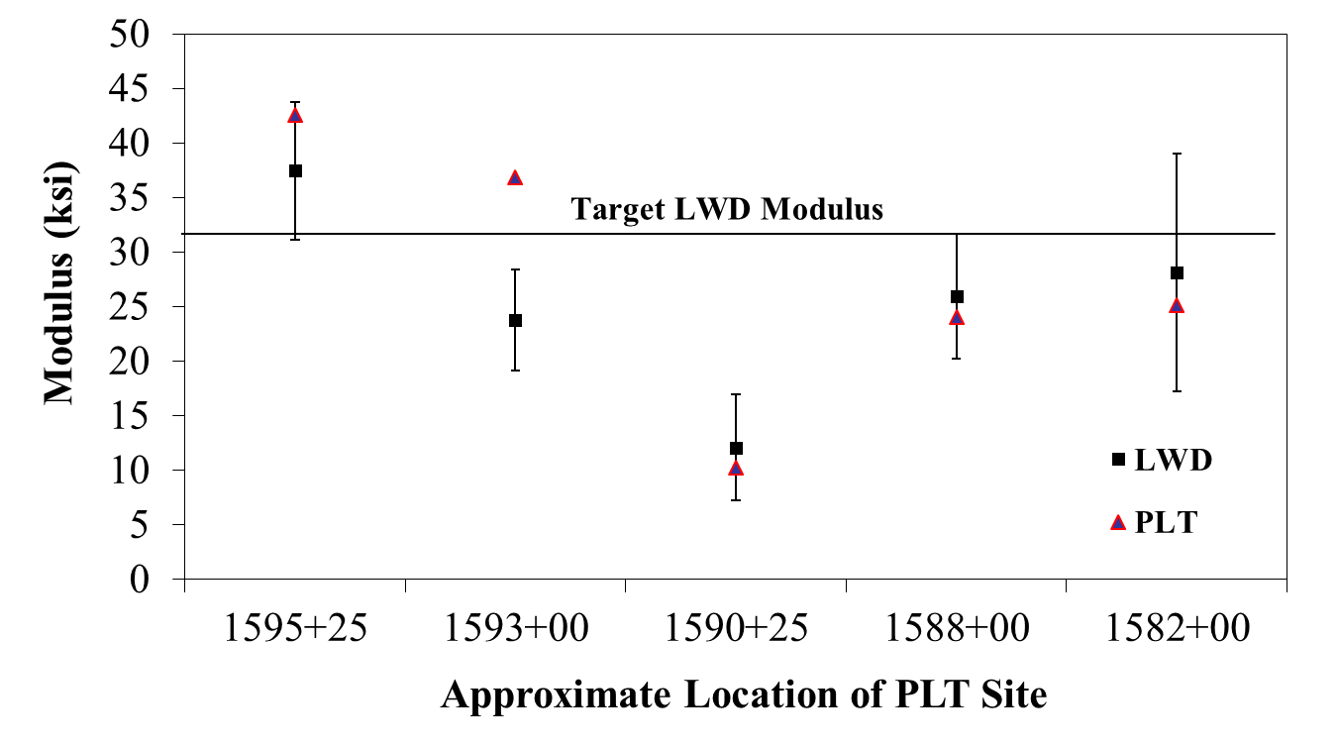
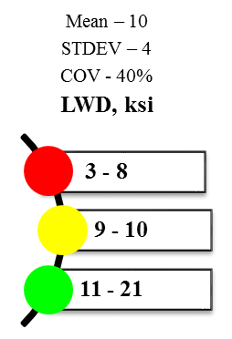
Field Process Control: Manage Variability
Use statistics to manage variability
20

Slide 21
Field Process Control: Moisture Content
Constant Density Specimens prepared at MDD

Slide 22
Field Process Control: Unsaturated Soil Principles
 |  | Moisture Content, %
 |  | 5% | 7% | 9% | 11% | 13% | 15% | 17% | 19% | 21% | 23% | 25%
Dry Density, pcf | 90 | 15% | 22% | 28% | 34% | 40% | 46% | 53% | 59% | 65% | 71% | 77%
 | 95 | 17% | 24% | 31% | 38% | 45% | 52% | 59% | 66% | 72% | 79% | 86%
 | 99 | 19% | 27% | 35% | 43% | 50% | 58% | 66% | 74% | 81% | 89% | 97%
 | 104 | 22% | 31% | 39% | 48% | 57% | 66% | 74% | 83% | 92% | 101% | 109%
 | 109 | 25% | 35% | 45% | 55% | 65% | 75% | 85% | 95% | 105% | 115% | 125%
 | 115 | 29% | 40% | 52% | 64% | 75% | 87% | 98% | 110% | 121% | 133% | 145%
 | 121 | 34% | 48% | 61% | 75% | 88% | 102% | 116% | 129% | 143% | 156% | 170%
 | 127 | 41% | 57% | 74% | 90% | 106% | 123% | 139% | 155% | 172% | 188% | 204%
 | 133 | 51% | 71% | 91% | 111% | 131% | 152% | 172% | 192% | 212% | 233% | 253%
 | 140 | 65% | 91% | 118% | 144% | 170% | 196% | 222% | 248% | 274% | 300% | 327%
 | 147 | 90% | 127% | 163% | 199% | 235% | 271% | 308% | 344% | 380% | 416% | 452%
 | 154 | 143% | 200% | 257% | 314% | 371% | 428% | 486% | 543% | 600% | 657% | 714%
Degree of Saturation, % | 120
 | 115
 | 110
 | 105
 | 100
 | 95
 | 90
 | 85
 | 80
 | 75
 | 70
 | 65
 | 60
 | 55
 | 50
 | 45
 | 40
 | 35
 | 30
 | 25
 | 20
 | 15
 | 10
 | 5
 | 0
S_{r} = ω G_{s} ρ_{d}/( G_{s} ρ_{w} – ρ_{d})
G_{s} = specific gravity
ρ_{d} = dry mass density
ρ_{w} = mass density of water

Slide 23

Intelligent Compaction for Uniformity
CMV
E_{vib}
CCV
K_{b}
MDP
VCV

Slide 24
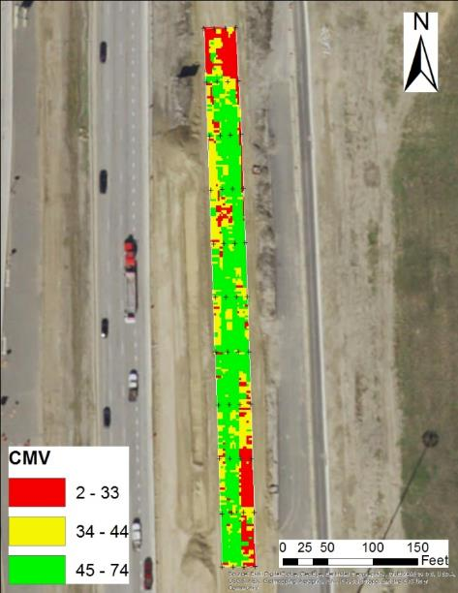
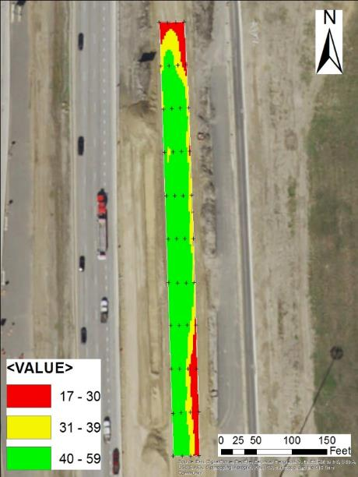
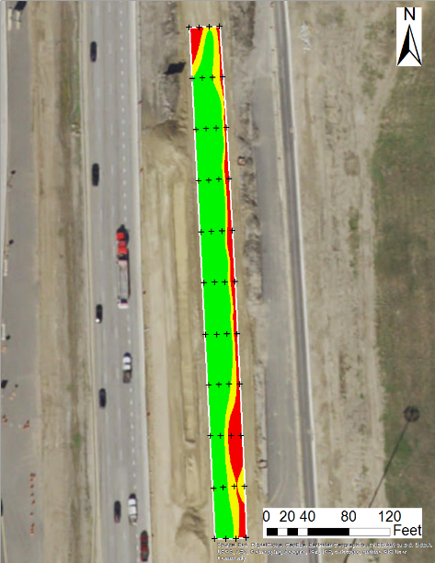
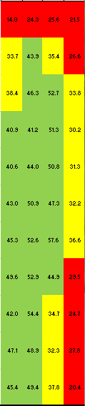
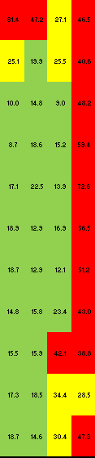

Field Process Control: Uniformity
Traditional
Sublot Concept
Mean – 44
STDEV – 12
COV - 27%
CMV
Mean – 39
STDEV – 10
COV - 26%
CMV
COV, %
2 – 33
34 – 44
45 – 74
14 – 30
31 – 39
40 – 58
35 - 82
25 – 34
8 – 24
Gridding
Kriging
CMV
COV of CMV

Slide 25
Step 5: Acceptance Process
Based on moisture-adjusted deflection
d_{adj} = d_{meas} / (K_{lab-field} K_{moist} )
Include in
target value
for convenience
K_{lab-field} adjusts for differences in lab and field moduli at same moisture content and density
K_{moist} adjusts for differences in compaction and testing moisture contents.

Slide 26
Impact of Delay in Testing
K_{moist} = e^{η(ωC-ωT)}
η = 0.18 for subgrades
η = 1.19 for unbound aggregates

Slide 27
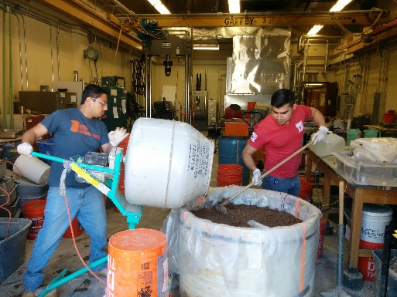
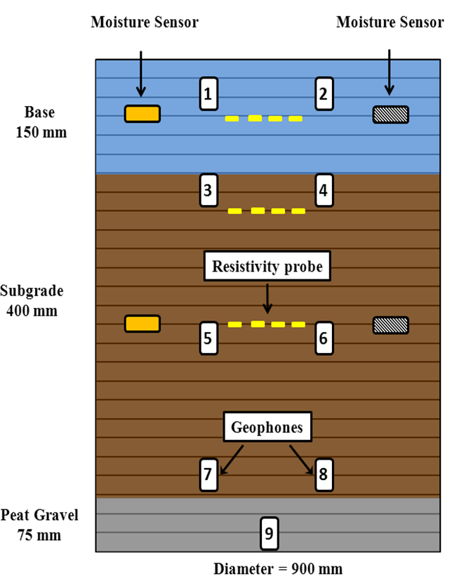
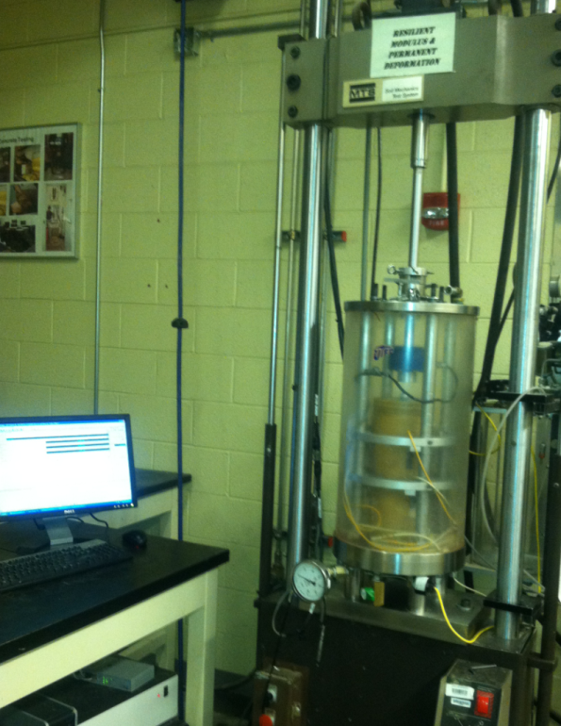
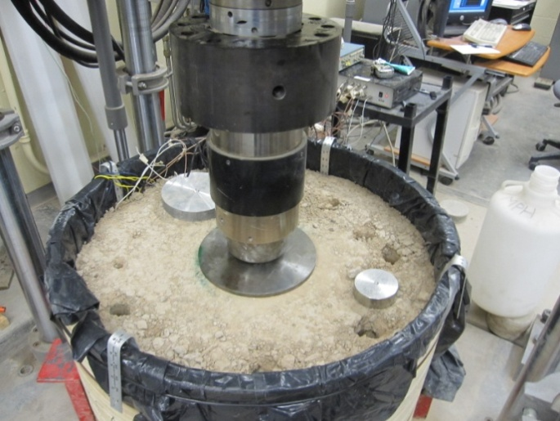
Field to lab Relationship
over 30 specimens

Slide 28
Lab vs. Field Moduli

Slide 29
Service Life
LWD
LWD
Backcalculation
Simulation
Tandem Axle
Rutting
12" Lime Treated Subgrade
12" Base +
8" LTS
12" Base
Service Life Reduction
7.5” HMA
500 ksi
12” Base
50 ksi
+
12” LTS 10 ksi
Subgrade
Comparison
Red < 75% of Average Value
Red < 75%

Slide 30
Service Life Reduction
Premature Failure

Slide 31
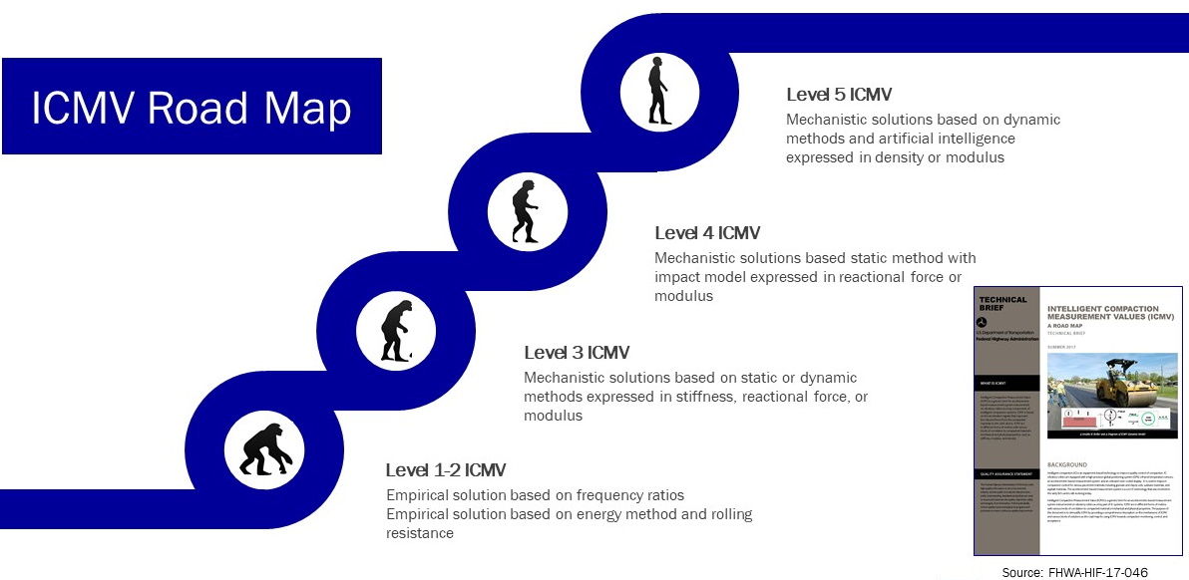
What is New and Exciting!!
Incorporating Intelligent Compaction in Performance Management
E (modulus)
k (stiffness)
CMV
CCV
HMV

Slide 32
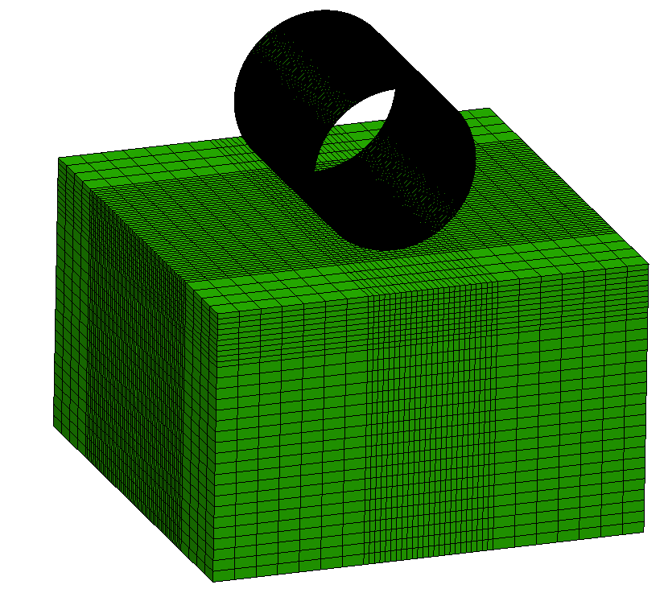
Need for Sophisticated Forward Model!!
Simulation of Roller Measurements
(Forward Model)
Roller Parameters
Material Types for Layers
Layer Properties
Practicalities!!
How to trust model (Calibrate)
How to speed up (Machine Learning)
Static vs.
Dynamic
Stationary vs. Vibratory
Linear vs.
Nonlinear
32

Slide 33
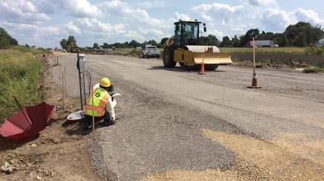
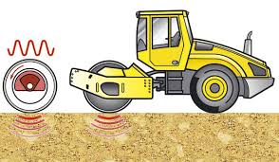
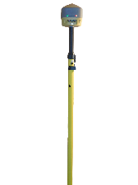
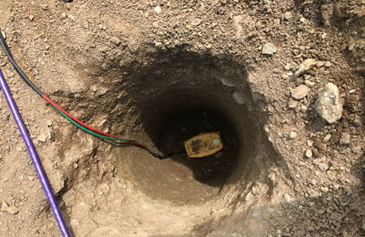




Calibration of Model
Moving Direction
h₁
Ground DAQ
h₂
Embedded
Geophones
Drum
FE Model
Pavement
Calibration
Geophone
Depths
33

Slide 34


Machine Learning as Forward Modeler
Artificial Neural Networks (ANN)
Pavement
Structure
Instantaneous Responses
Material
Properties
INPUT
Roller
Features

Slide 35


Estimation of E or k
Inputs
Operating
Conditions
F_{ev}
D_{drum}
l_{drum}
⁝
_{etc.}
d
Base
h
k’₂, k’₃
Subgrade
k‘₁, k’₂, k’₃

Slide 36

Importance of Local Calibration
36

Slide 37

Estimating Modulus using Artificial Intelligence
R² = 0.98
SEE = 14 MPa
0
20
40
80
100
120
140
160
200
Station, ft

Slide 38
Retrieved Modulus vs. LWD Modulus

Slide 39


Concluding Remarks
They did the best they could with what was available to
them ~70 years ago to solve a major problem
Engineering community pragmatically agreed that those
tests improve quality, even though not perfect
Let’s us pragmatically work toward
implementing modulus-based technology
to improve further construction quality
even though not perfect

Slide 40



More info!!

Slide 41






Thank you!!
A number of colleagues and students
  Cesar Tirado
  Sergio Rocha
  Mehran Mazari
  Aria Fathi
41

