Slide 1
Investigation of the Effects of End Region Deterioration in Precast, Prestressed Concrete Bridge Girders
Royce Floyd, Cameron Murray, Darion Mayhorn
DONALD G. FEARS STRUCTURAL ENGINEERING LAB
The UNIVERSITY of OKLAHOMA

Slide 2
Outline
Background
Field Investigation
Small Scale Tests
Conclusions

Slide 3
Introduction
Initial concerns by ODOT
Shear rating of older bridges
End region cracking
How are these connected?

Slide 4
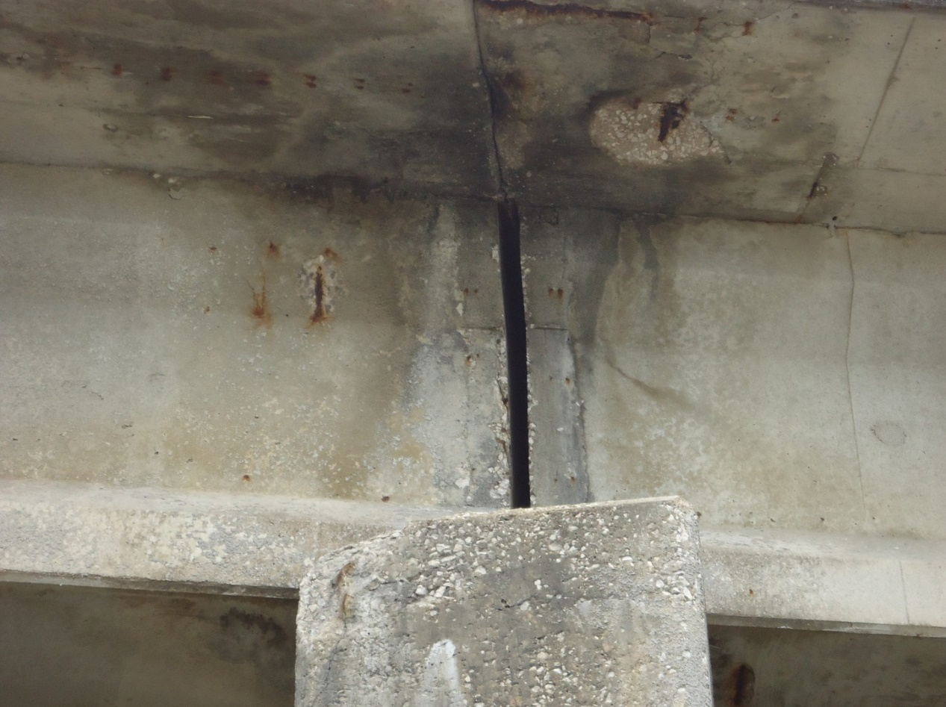
Background
Large concentration of steel in end regions
Leaking expansion joints

Slide 5
Background
Corrosion may have larger effect in prestressed elements
larger percentage section loss [1], higher stress [2]
Corrosion deterioration reduces capacity [3,4,5]
Minor corrosion can increase bond capacity [6]
Notes:
Either flexure loading or bond tests

Slide 6
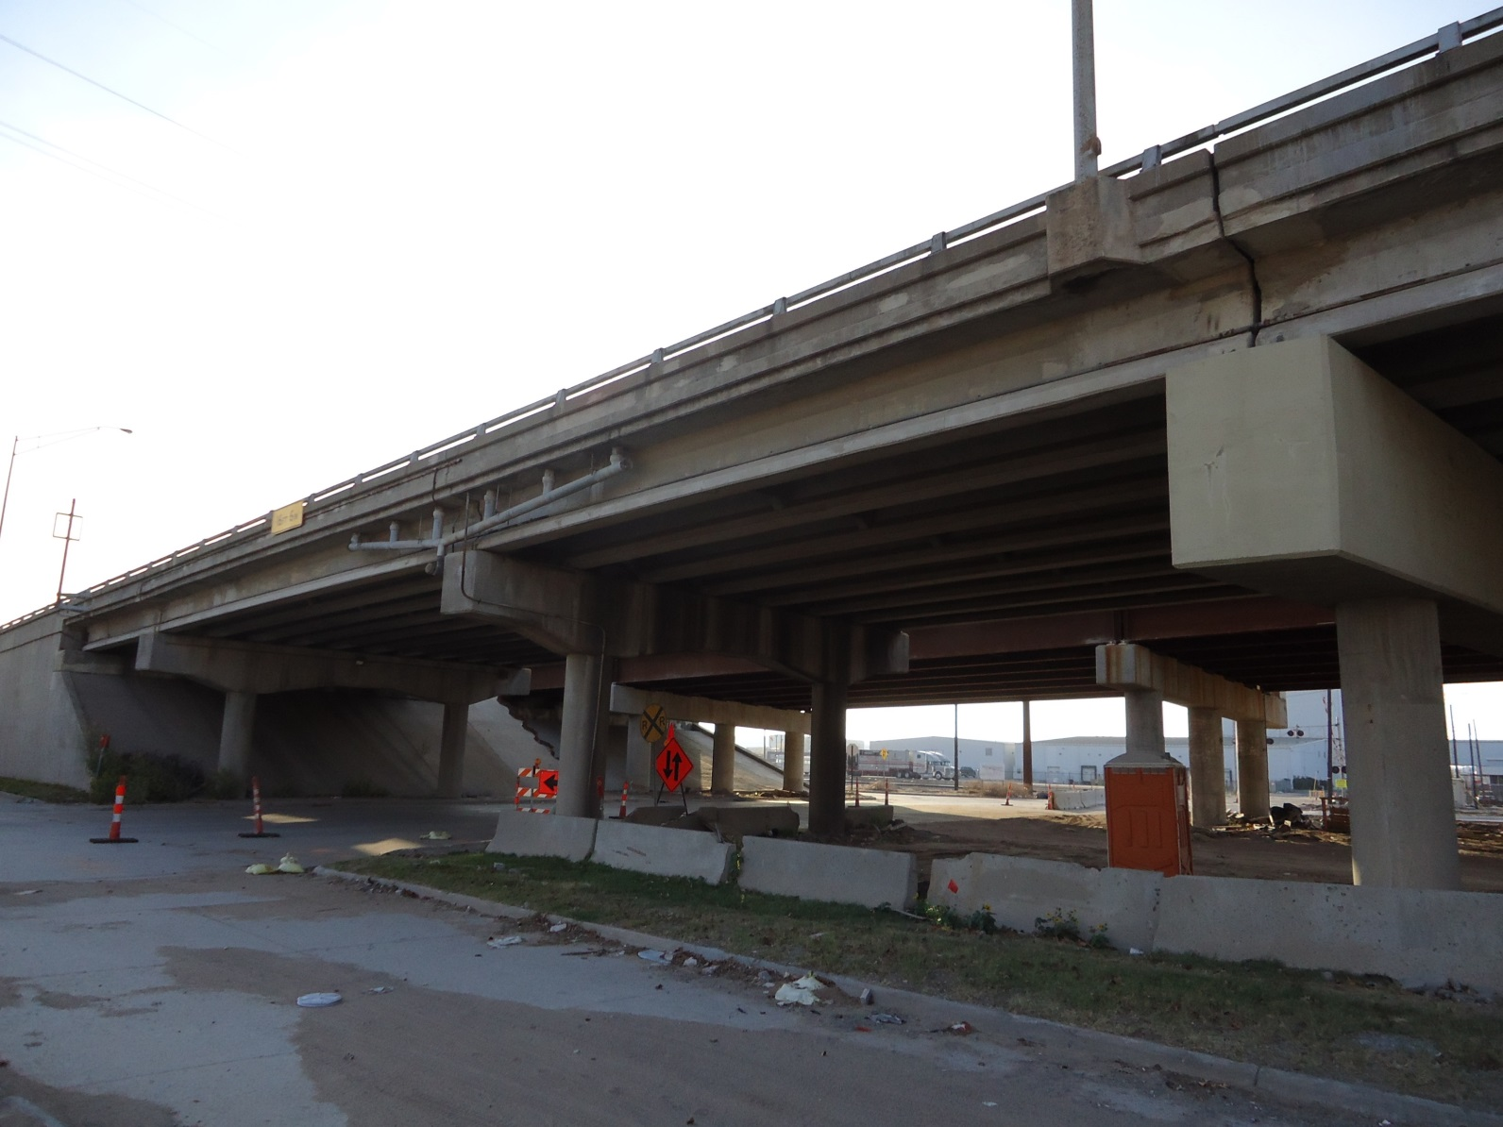
Testing Two Full-Scale, aged girders
I-244 Tulsa
30 ft girder
46 ft girder

Slide 7
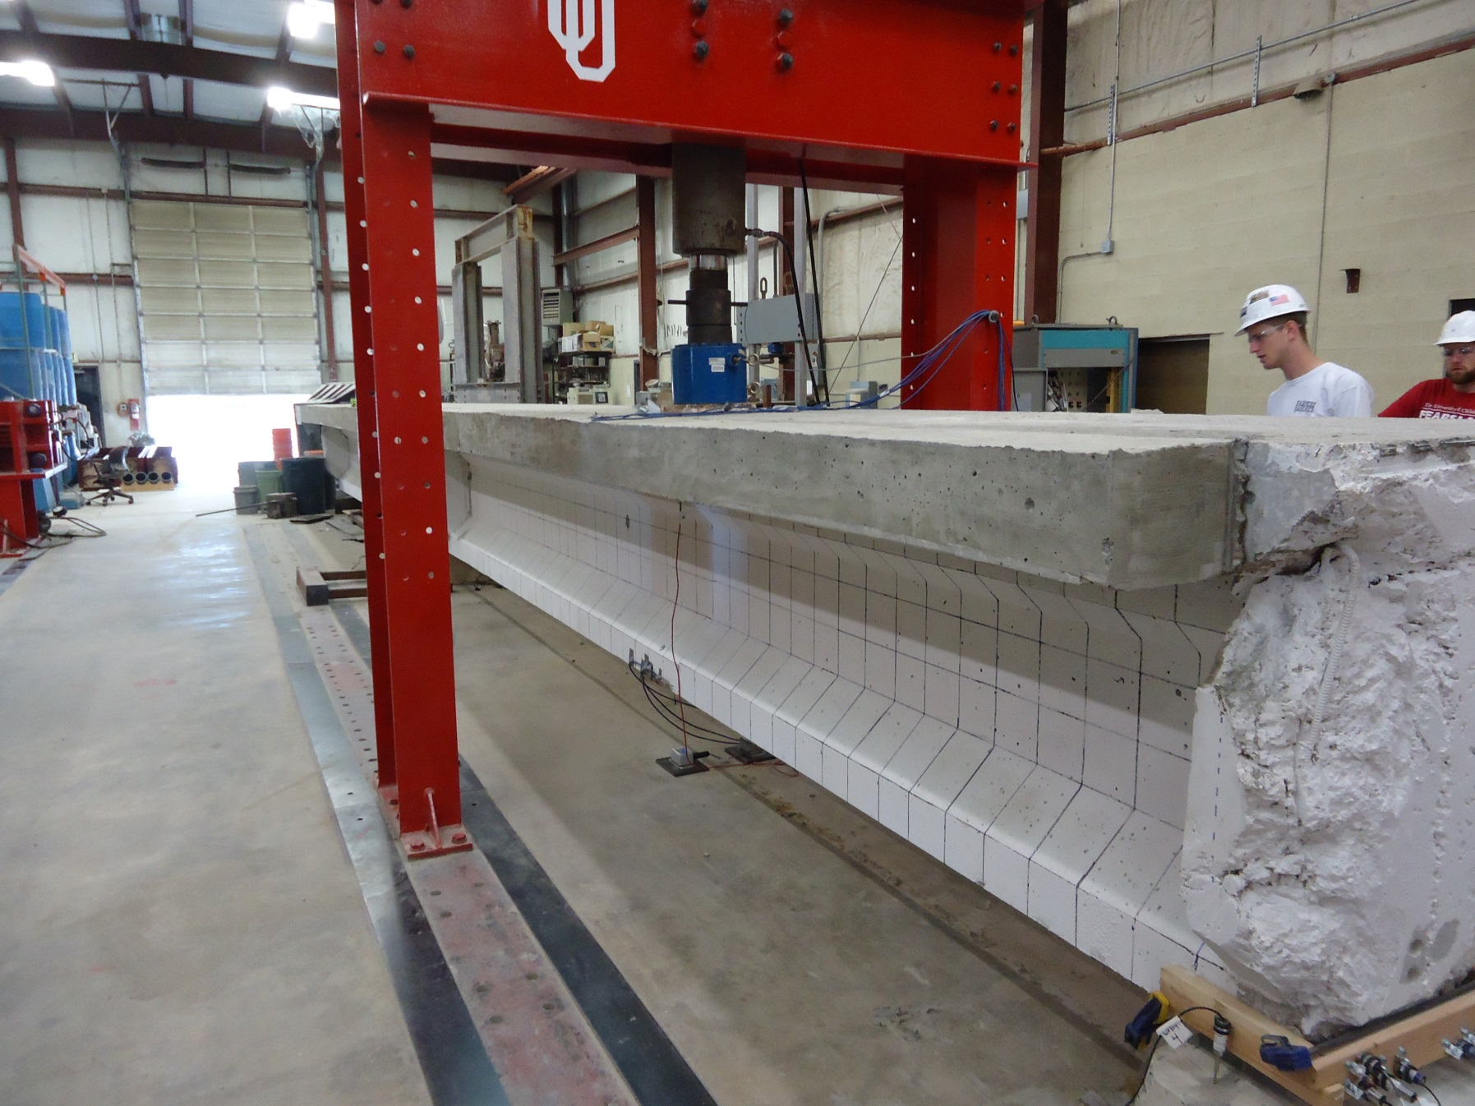
Full Scale Tests

Slide 8
Field Inspections
Visited 19 Oklahoma Bridges
Built from 1960 – 1979
Prestressed Concrete
Stringer/Multi-beam or Girder
Varying Superstructure Ratings
Identify Common Features

Slide 9
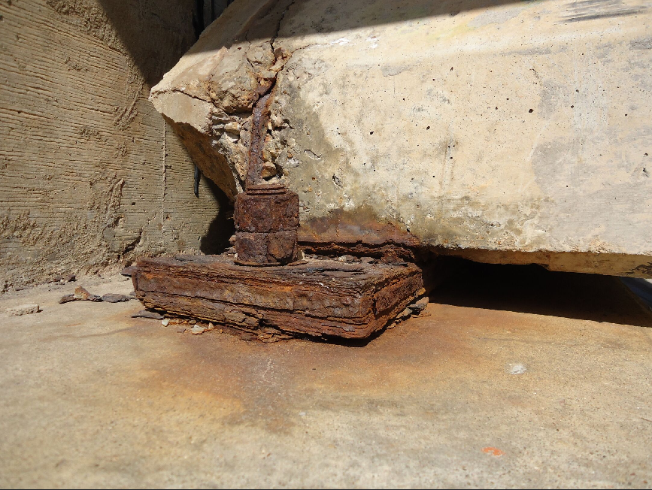
Common Characteristics
Corroded bearing plates
Corroded anchor bolts
Spalling above the support
Exposed rebar and prestressing strands
Notes:
Diagonal cracking of the back corner of the girder
Vertical cracking along the girder and diaphragm interface
Diagonal cracking from the top flange and web interface
Diaphragm deterioration

Slide 10
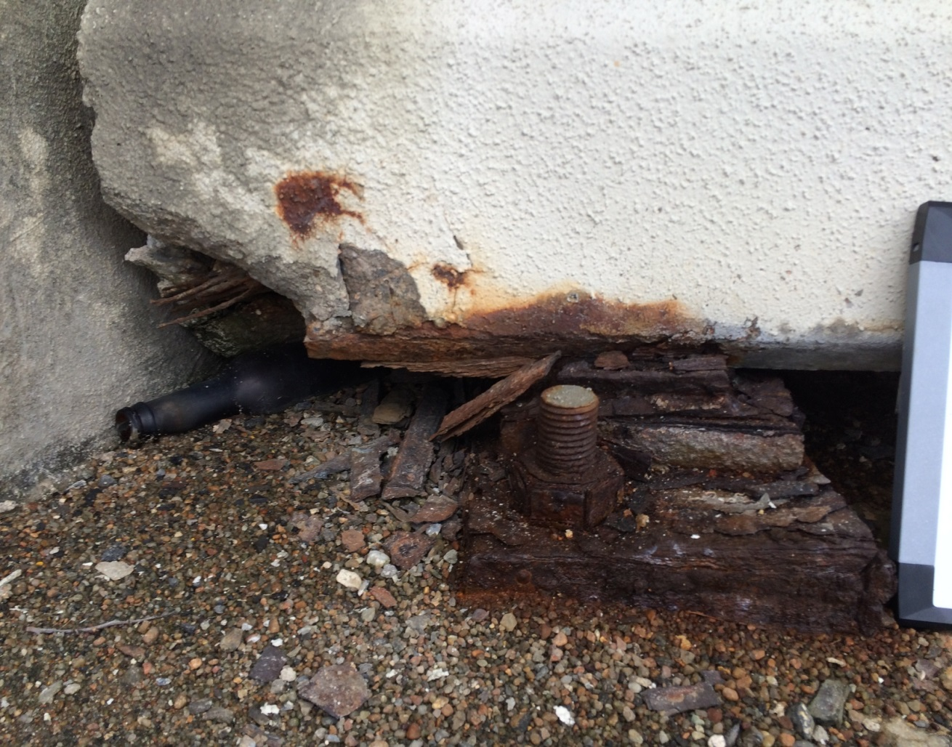
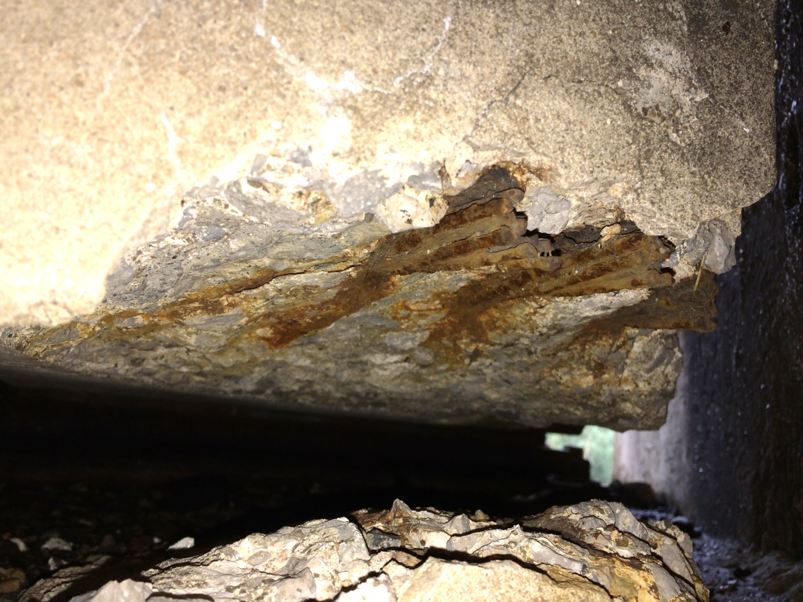
Corrosion at Girder Ends

Slide 11
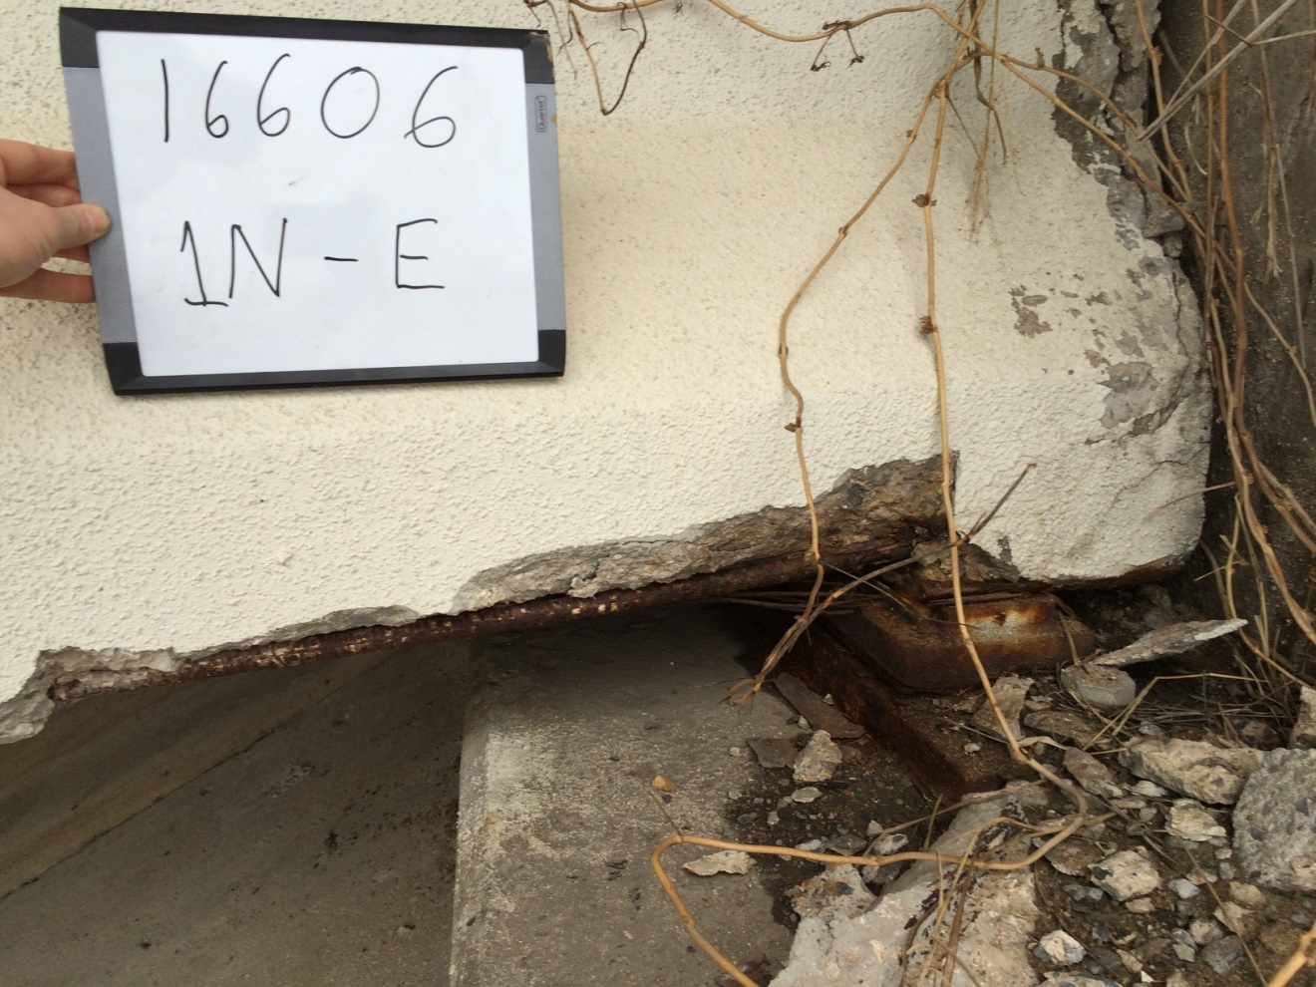
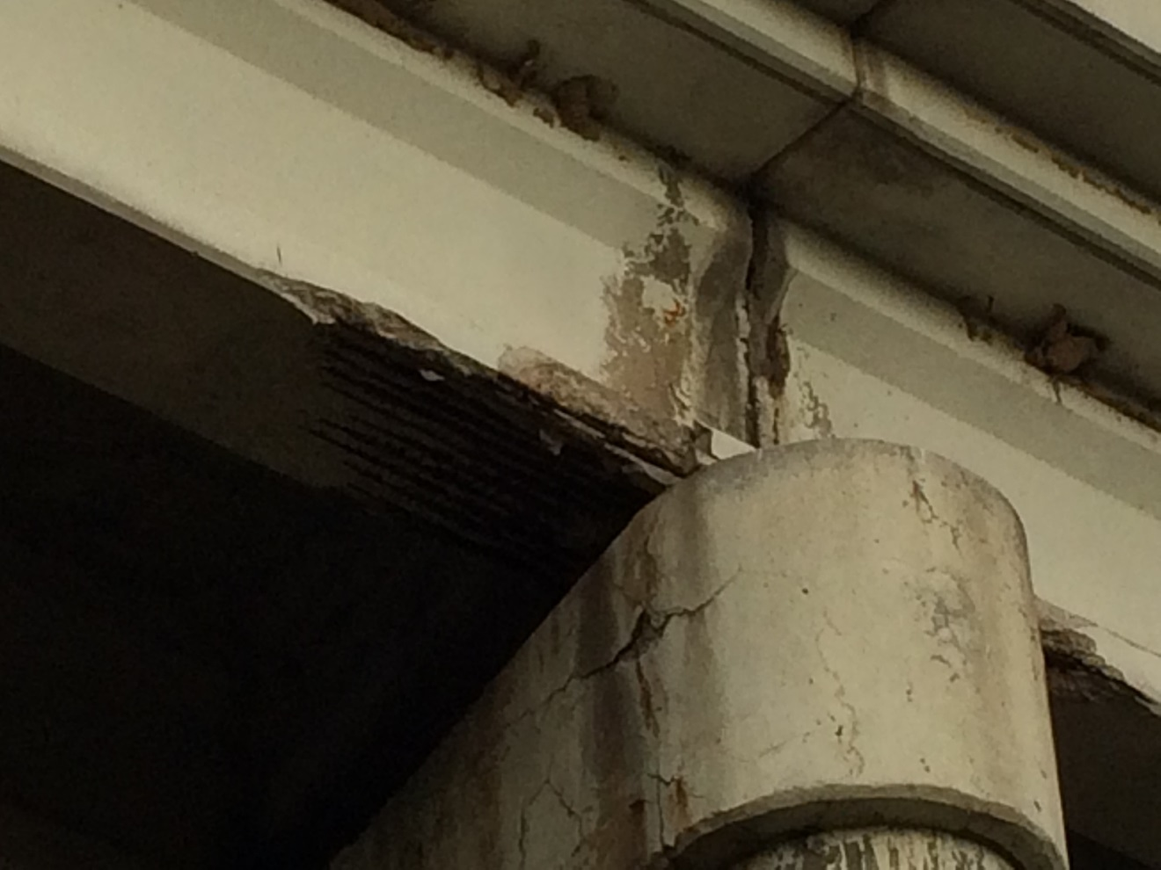
Corrosion at Girder Ends

Slide 12
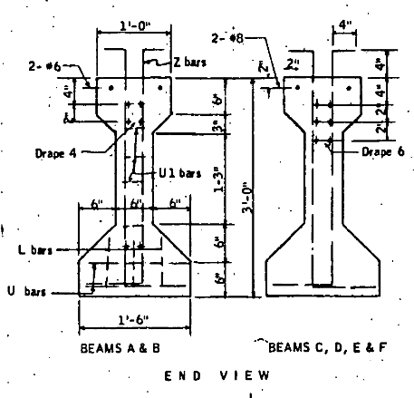
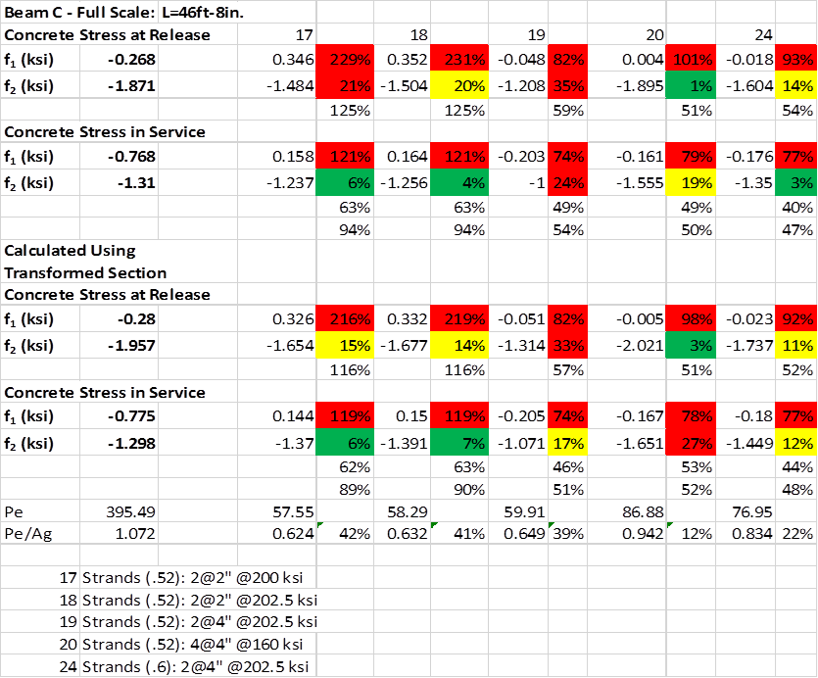
Small-Scale Tests
½ Scale Girders
Girder A and C Designs
Notes:
From original design drawings, targeted equivalent compression and tension stresses
18 ft long, 22 in. deep, two ½ in. special or two 0.6 in. strands

Slide 13
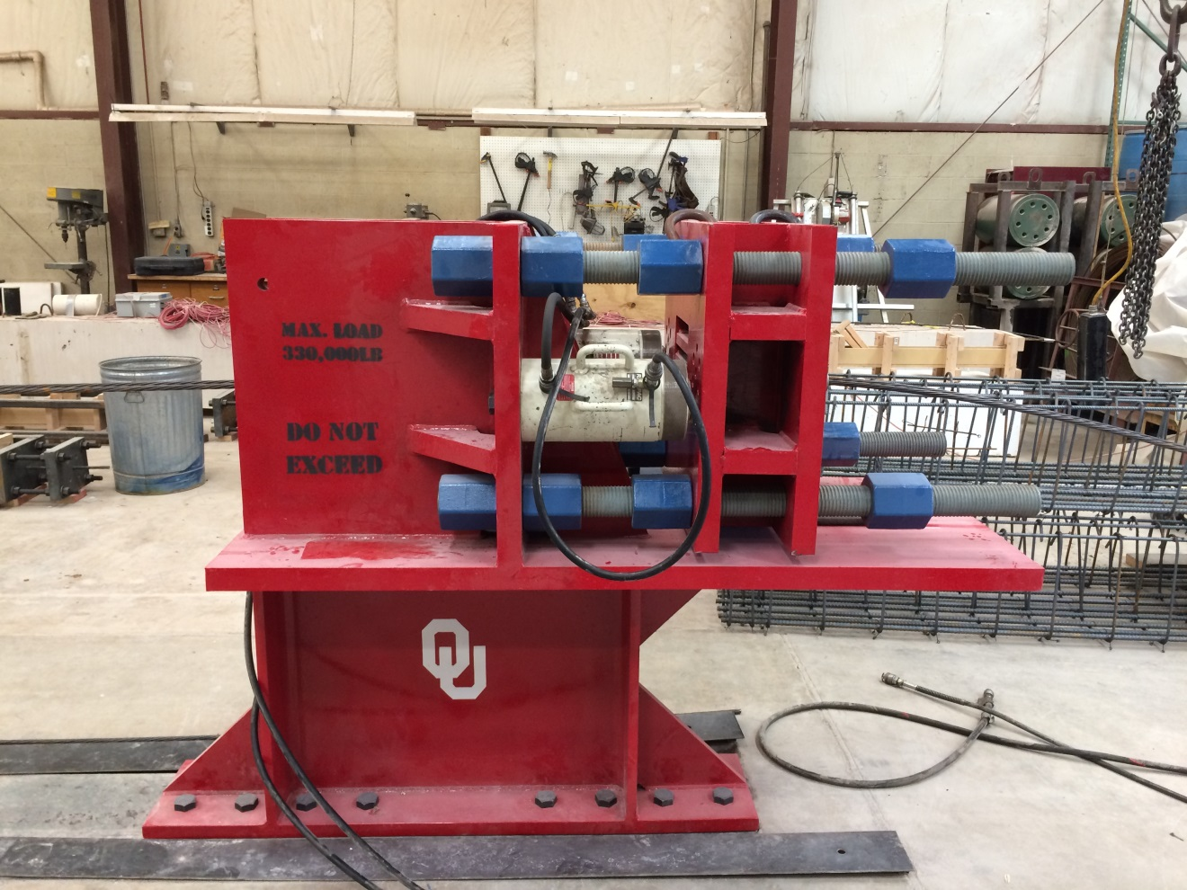
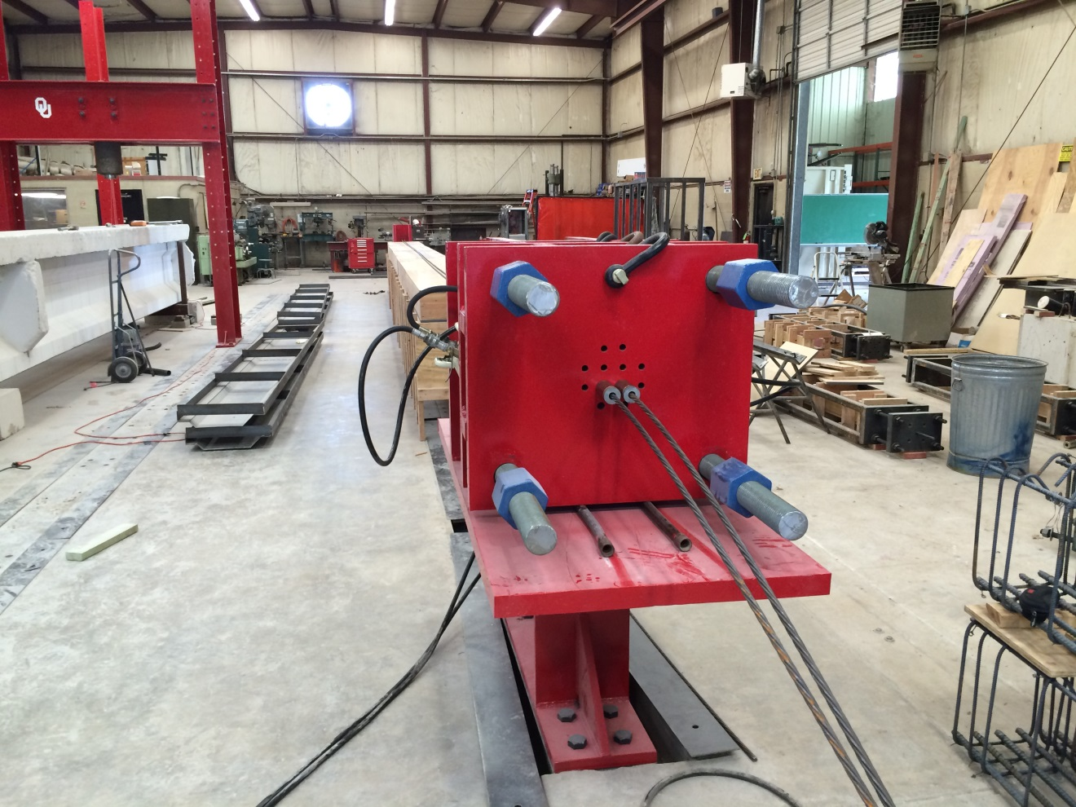
Small-Scale Tests

Slide 14
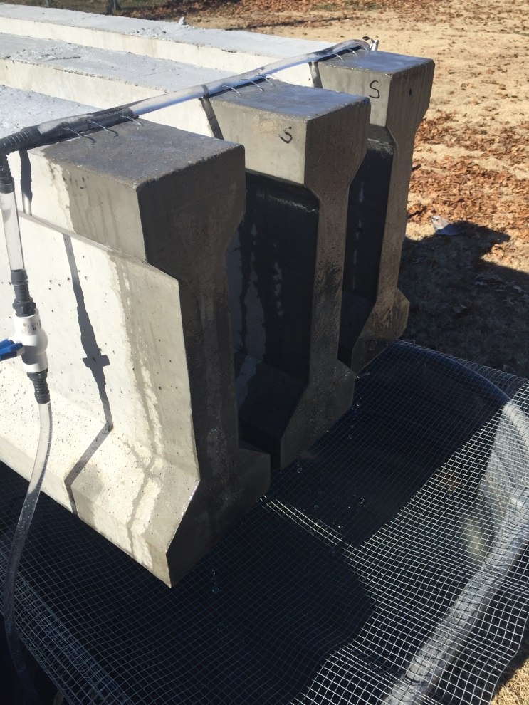
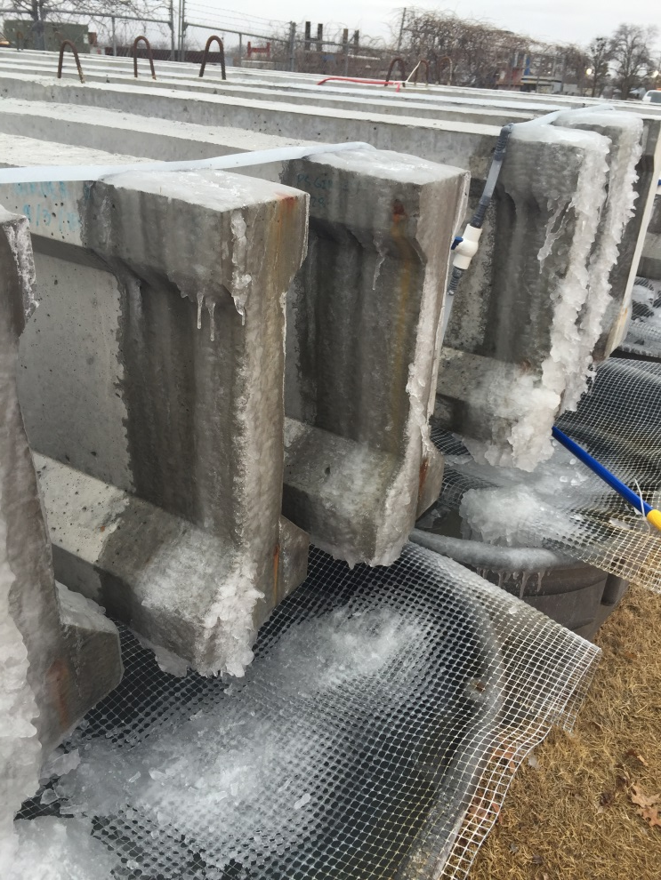
Small-Scale Tests
Accelerated Corrosion
Notes:
2 month, 4 month, 6 month

Slide 15
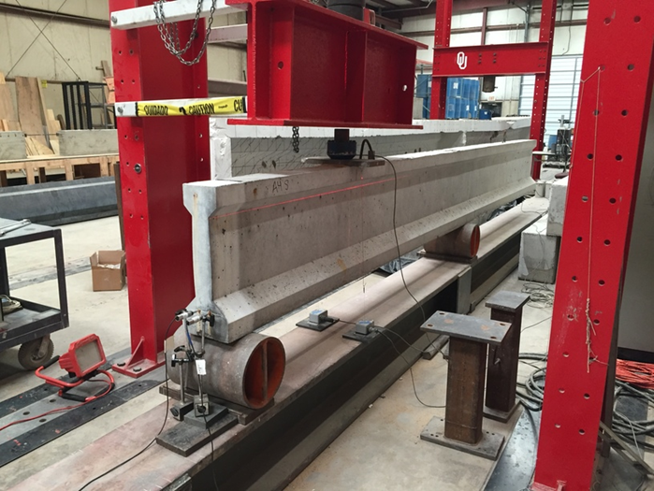
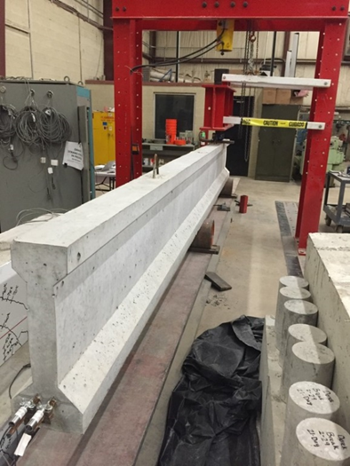
Small-Scale Shear Tests
Notes:
Load, deflection, and end slip, cantilever to test both ends,

Slide 16
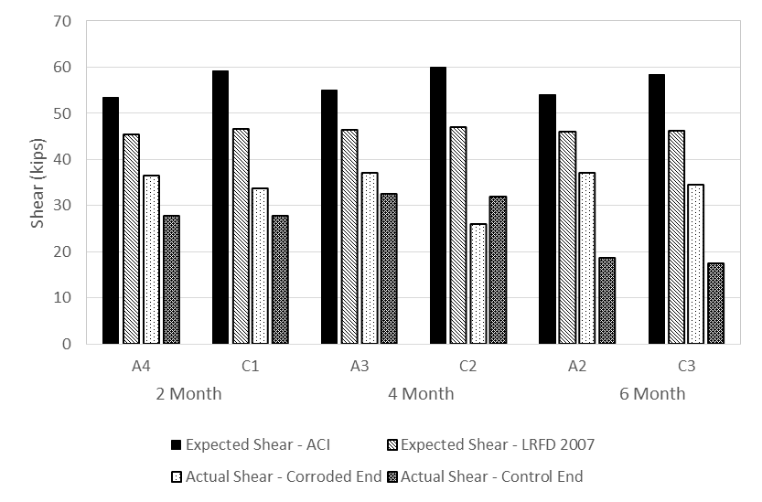
Small-Scale Shear Tests
Notes:
Corroded ends had larger experimental capacities, girder A design slightly higher strength due to less slip from smaller strands, only noticeable strength degradation over time for three girders

Slide 17
Conclusions
Corrosion at the girder ends affected behavior
Corroded ends of the small-scale members exhibited larger measured shear strengths for the conditions tested
Slip measured before cracking for corroded small-scale specimens

Slide 18
Future Research
Examine longer corrosion exposure times
Quantify effects of corrosion level on bond capacity
Examine effect of repairs

Slide 19
Thank you
DONALD G. FEARS STRUCTURAL ENGINEERING LAB
The UNIVERSITY of OKLAHOMA

Slide 20
References
Bruce, S. M., McCarten, P. S., Freitag, S. A., & Hasson, L. M. (2008). Deteoriation of Prestressed Concrete Bridge Beams. Land Transport New Zealand Research Report 337.
R. Szilard, "Corrosion and Corrosion Protection of Tendons in Prestressed Concrete Bridges," ACI Journal, pp. 42-59, January 1969.
R. A. Rogers, L. Wotherspoon, A. Scott and J. M. Ingham, "Residual strength assessment and destructive testing of decommissioned concrete bridge beams with corroded pretensioned reinforcement," PCI Journal, vol. 57, no. 3, pp. 100-118, 2012.
M. K. ElBatanouny, J. Mangual, P. H. Ziehl and F. Matta, "Early Corrosion Detection in Prestressed Concrete Girders Using Acoustic Emission," Journal of Materials in Civil Engineering, vol. 26, no. 3, pp. 504-511, 1 March 2014.
T. M. Pape and R. E. Melchers, "Performance of 45-year-old corroded prestressed concrete beams," Structures and Buildings, vol. 166, no. SB10, pp. 547-559, November 2013.
I. Abosrra, A. F. Ashour and M. Youseffi, "Corrosion of Steel Reinforcement in Concrete of Different Compressive Strengths," Construction and Building Materials, 23 May 2011.

Slide 21
Small-Scale Testing Summary
 |  | Corrosion Accelerated End | Control End
2-Month Tests | Girder A4 | Bond-shear failure; slip before cracking | Bond-shear failure; cracking before slip
 | Girder C1 | Bond-shear failure; slip before cracking | Bond-shear/flexure failure; cracking before slip; flange deterioration
4-Month Tests | Girder A3 | Bond-shear failure; slip before cracking | Bond-shear failure; maybe flexural failure first; cracking before slip
 | Girder C2 | Bond-shear failure; slip before cracking | Bond-shear failure; cracking before slip
6-Month Tests | Girder A2 | Web-shear failure | Bond-shear failure; cracking before slip
 | Girder C3 | Bond-shear/flexure failure; cracking before slip; concrete crushed at load point | Bond-shear failure; cracking before slip

Slide 22
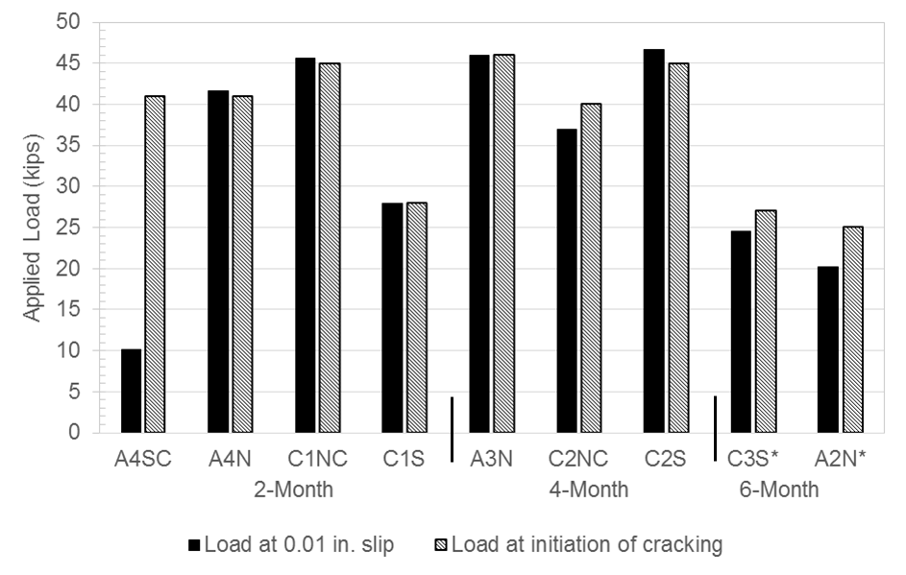
Small-Scale Shear Tests
Notes:
(*Note: C3S and A2N decreased in loading after cracking and then slip occurred at that decreased load)

